Slide 1
AIRPORT DELAYS
OVANDO CARTER
Data Engineering Consultant – FDM Group.

Slide 2
What do you want to find out
When is the best time to fly to minimize delays?
Focus on:
Time of day
day of week
time of year
Operational Efficiency
Which airport has the least delays
Used Pyspark via Databricks as it is 100 times faster than Hive and more accurate.
Published: https://databricks-prod-cloudfront.cloud.databricks.com/public/4027ec902e239c93eaaa8714f173bcfc/4034538166551726/3720966754352786/5722510562859543/latest.html
Notes:
Though could use Hive to check results.
Only focused on the main three csv files
2019-01.csv, 2019-02.csv, 2019-03.csv

Slide 3
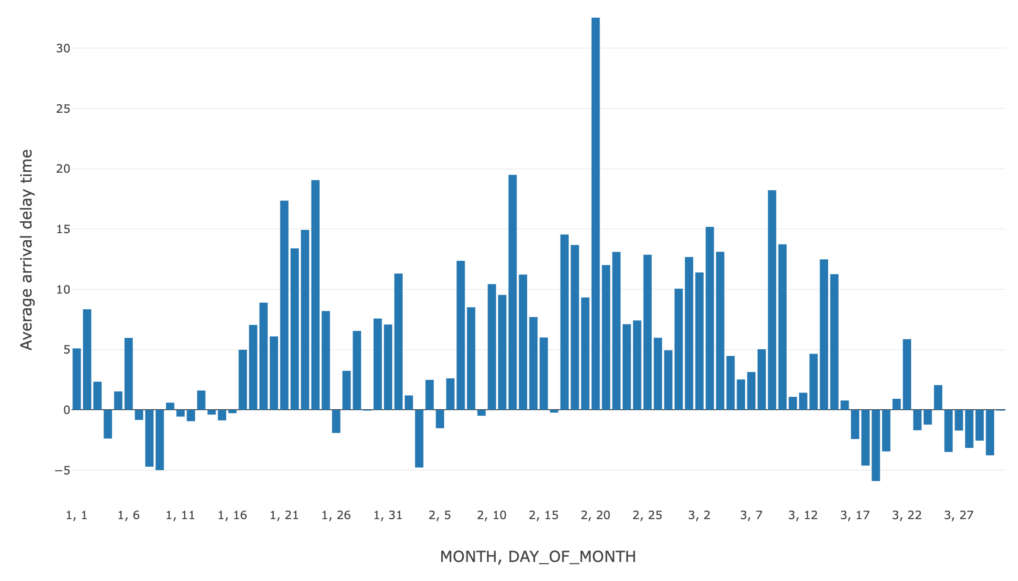
Average Arrival Delay Time per Day Of Month from Jan – Mar.
Notes:
# ingested data using spark.read.format(fileType) method, and worked on the data via dataframes.
# comments:
# looking at the data we can see missing data entries, also negative numbers on arrival delays? why?
# note some entries have zero as a value so the ones without data seem to just have no entry.
# decided to focus on arrival delays as the data was more complete.
# looking at the data we can see some points in the month express a greater number of delays.

Slide 4
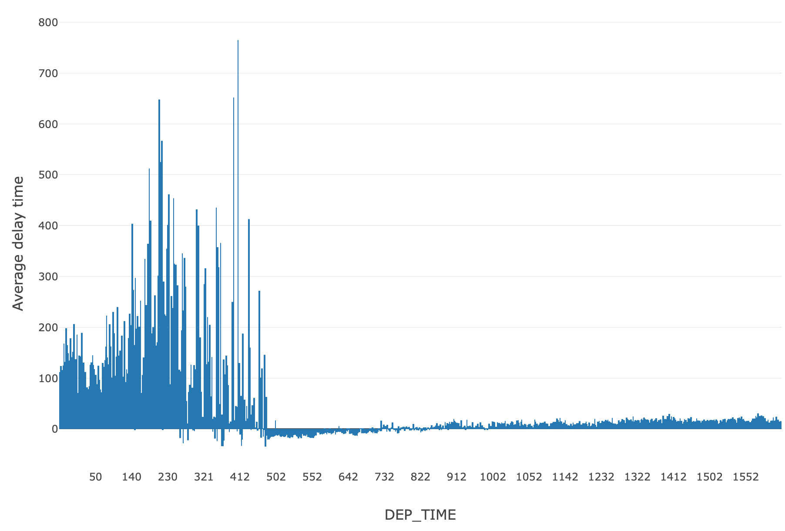
Average Delay Time per Hour of Day (2019)
Example Jan 2019:
Notes:
# decided to keep the data separate at this stage for clarity.
# departure time vs arrival delays
# note:
# delays cased by the plane arriving at your starting airport is not the same as delays that occur on route which contribute to the arrival delay time.
# arrival delay time, can include weather, diversions, inability to land at the airport as another plane is still on the runway.
# again other data seemed just to be factors that arrival delay already covered, yet was missing a complete dataset so were not used.
# note:
# most of the biggest delays can be found from midnight to around 4 am, when most people are asleep. The least delays are occurring from around 6 am - 4 pm which might be the prime times for most travelers.
# note:
# its might say 4:47 am is the best time but actually it is risky. Also, you would potentially be between other flights that are potentially going to pick a flight that could have large delays. If you arrive late your plan will have left early. Actually any time from 5 - 7 am is a good time.

Slide 5
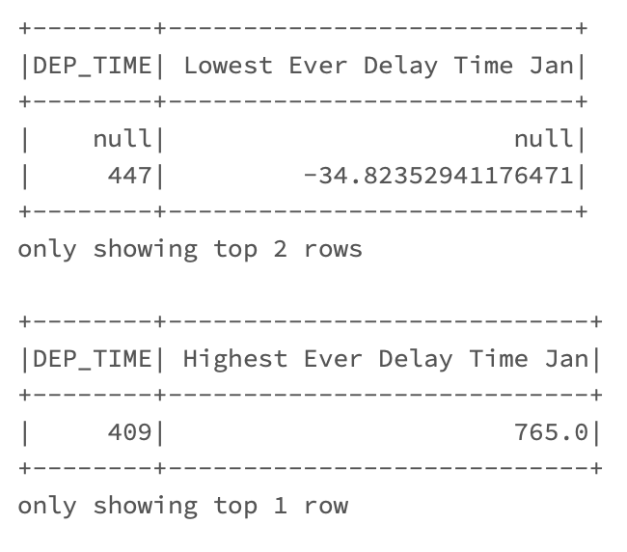
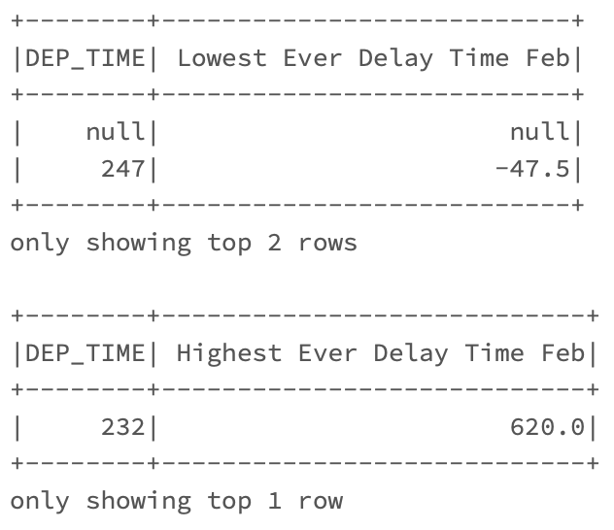
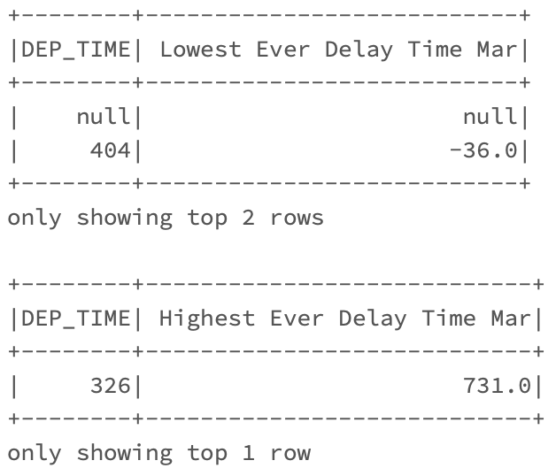
Lowest Average Delay Time per Month

Slide 6
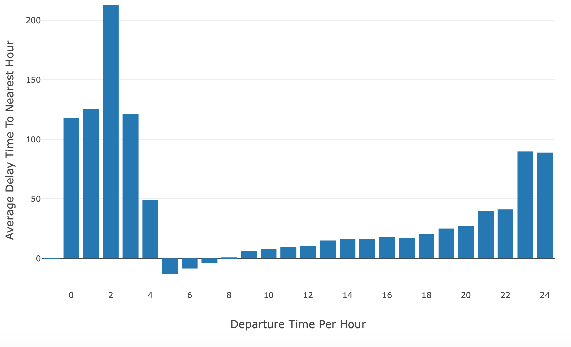
Example Jan 2019:
More accurately, we can see that the best time is 5 am.

Slide 7
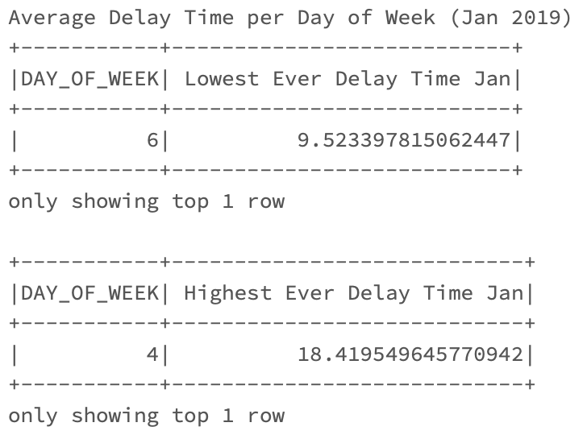
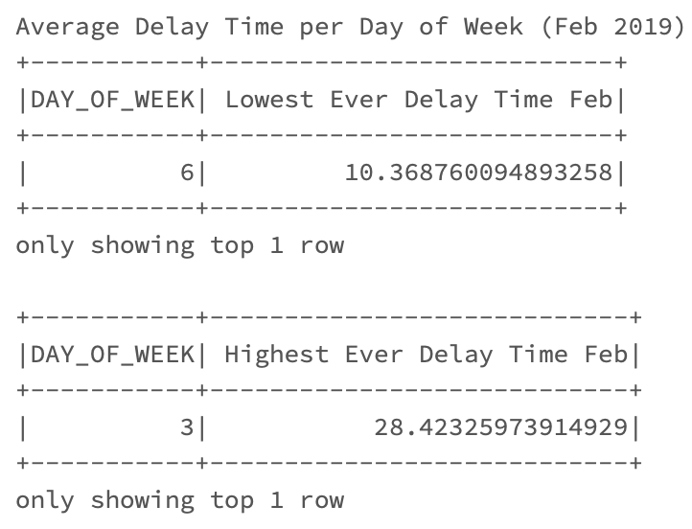
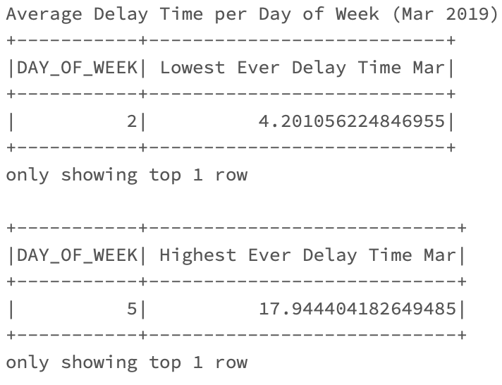
Lowest Delay Time Vs Day Of Week

Slide 8
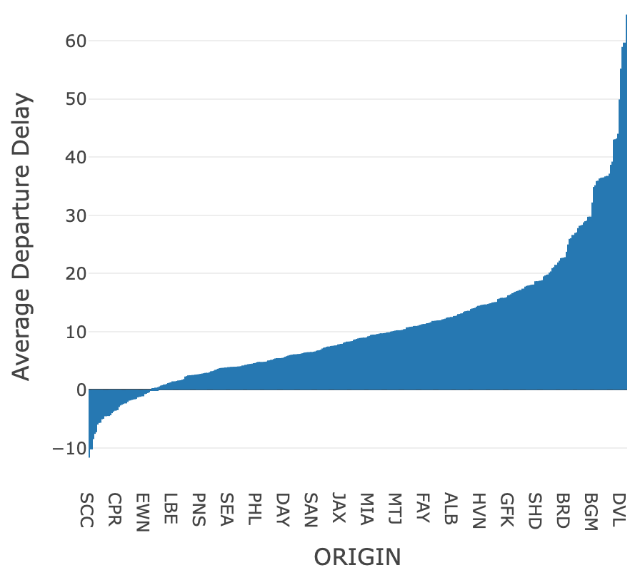
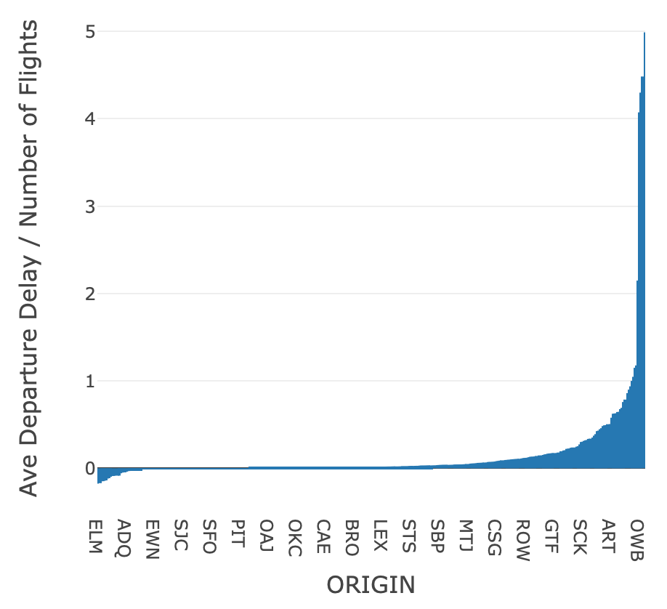
Operational Efficiency - Delay Time vs Origin(Feb 2019)
which airport has the least delays:
need to do the mean of all the flights and then represent them in a graph
one airport could be bigger than another airport and so gets more delayed flights just because it gets more flights in general.
Notes:
Challenge
# airport that has largest departure delay per flight
# note:
# one airport could be bigger than another airport and so gets more delayed flights just because it gets more flights in general.
# need to do the mean of all the flights and then represent them in a graph
# groupby("ORIGIN") vs mean("DEP_DELAY") gives average departure delay per origin airport
# groupby("ORIGIN") vs sum("DEP_DELAY") gives number of flights per origin airport

Slide 9
OE - Delay Time 2019
Departure:
Month Highest Delay/ flight
Jan OGS (Ogdensburg International Airport) – 4.99 min/flight
Feb OTH (Oregon Regional Airport) – 3.81 min/flight
Mar ELM (Paine Field) – 1.74 min/flight
Arrival:
Month Highest Delay/ flight
Jan OGS (Ogdensburg International Airport) ) – 4.18 min/flight
Feb HGR (Hagerstown Regional Airport) – 1.78 min/flight
Mar OTH (Oregon Regional Airport) – 1.16 min/flight

Slide 10
Conclusion
Lowest average delay time:
Jan at 5 pm approx. 35 mins early
Day with the Lowest delay time:
Mar: Tuesday 4 mins 20 sec
Jan: Saturday 9 mins 58 sec
Feb: Saturday 10 min 37 sec
Airport Operational Efficiency
Jan for both arrival and departure
Outbound: Ogdensburg International Airport – 4.99 min/flight
Inbound: Ogdensburg International Airport – 4.18 min/flight
Notes:
Challenges
# lack of data for other types of delays
Carrier delays
weather delays
NAS delays
Security delays
late aircraft delays
meant that I was limited.
# I struggled with getting all the data in to one query, as I found these answers in two different queries the day being Tuesday and the Months Jan at 5 pm are not relay related and so are slightly misleading.

Slide 11
Thank You

